Slide 1
Software group Project –IV Guided By: Asst. Professor Ms. Nishat shaikh Subject :-Data Analytics and Data Visualization Name: Neel Hetalkumar Shah ID: 18IT124 Btech (I.T) – CSPIT, CHARUSAT
Let’s see Data

Slide 2
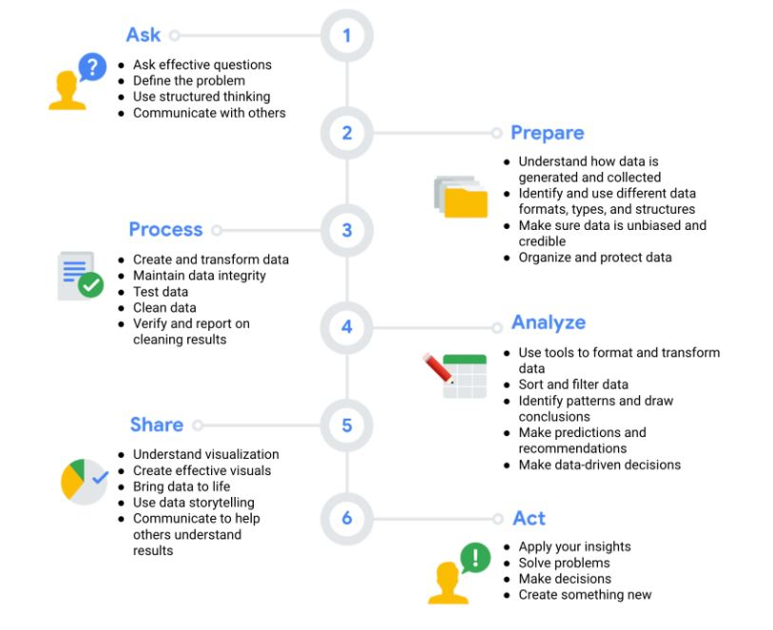
There are six phases of data analysis

Slide 3
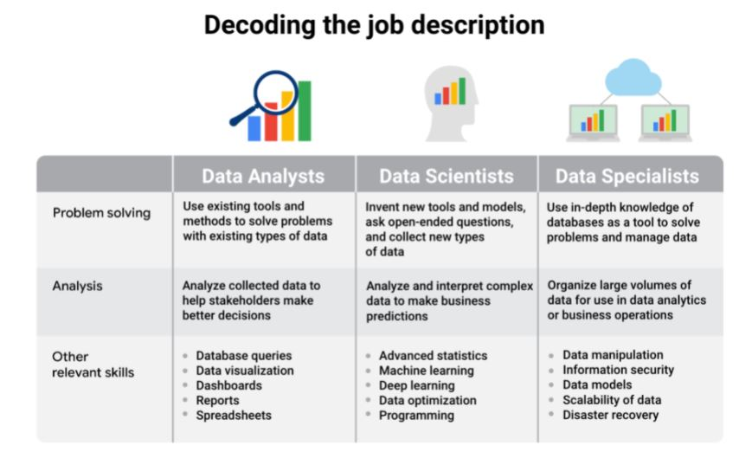
What is Data?
Data is processed or generated information.
It is present everywhere
On an average a human body generates 1.5 Gb of data everyday
Roles of handling data:

Slide 4
Microsoft Power BI Vs Tableau
Power BI is a collection of software services, apps, and connectors that work together to turn your unrelated sources of data into coherent, visually immersive, and interactive insights. Your data may be an Excel spreadsheet, or a collection of cloud-based and on-premises hybrid data warehouses.
Tableau is a powerful and fastest growing data visualization tool used in the Business Intelligence Industry. It helps in simplifying raw data in a very easily understandable format. Data analysis is very fast with Tableau tool and the visualizations created are in the form of dashboards and worksheets.

Slide 5
My work: determining stress levels of different countries based on multiple parameters.
When it comes to stress levels of a nation, It depends on multiple parameters.
Financial stress
Social stress
Emotional stress
Physical stress
Peer stress
Work stress
I have used some datasets from sources like:
Kaggle
Nasa stats
Data.world
Etc.
To determine, compare and visualize some parameters on Power BI
Learning Source:
Coursera

Slide 6
Future scope
My Research paper topic in Multiple Heterogeneous data and visualizing it using different tools like power BI and Tableau has been inspired from United Nations (UN) https://www.un.org/en/
This can help non governmental organizations to act according to the stress state of the locations. This will help profitable institutes to manufacture, process and retail according to the demand and supply of the place.

Slide 7
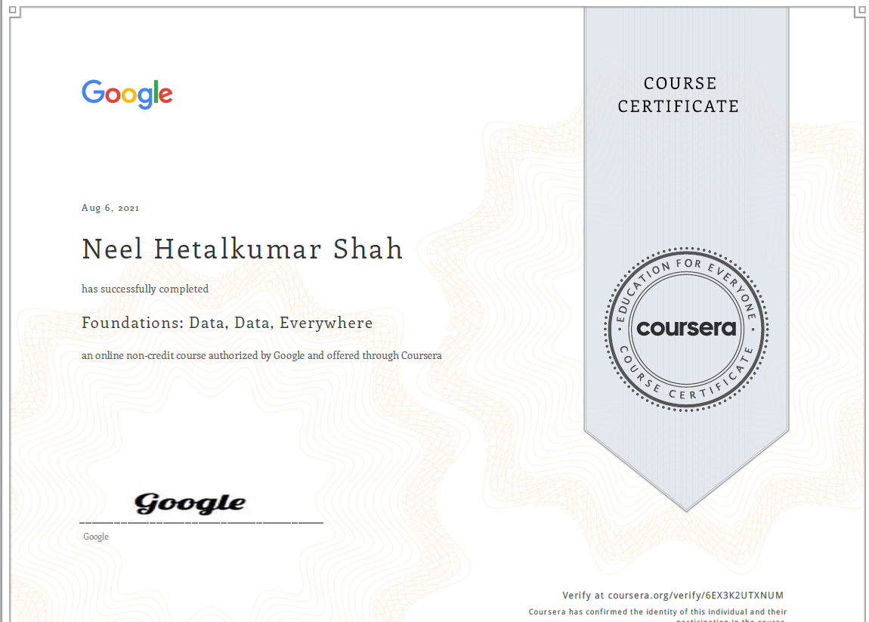
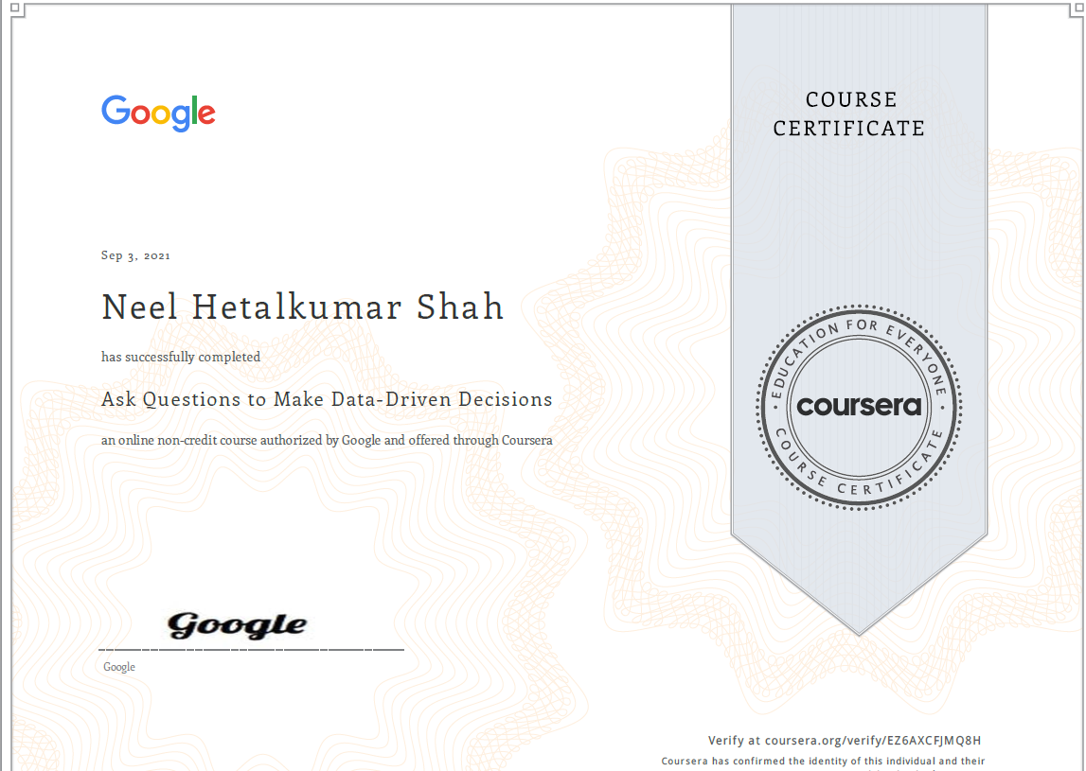
Thank You!
Github Link: https://github.com/neelshah124/SGP-IV-Power-BI-data/tree/main
Learning outcome

